Slide 1
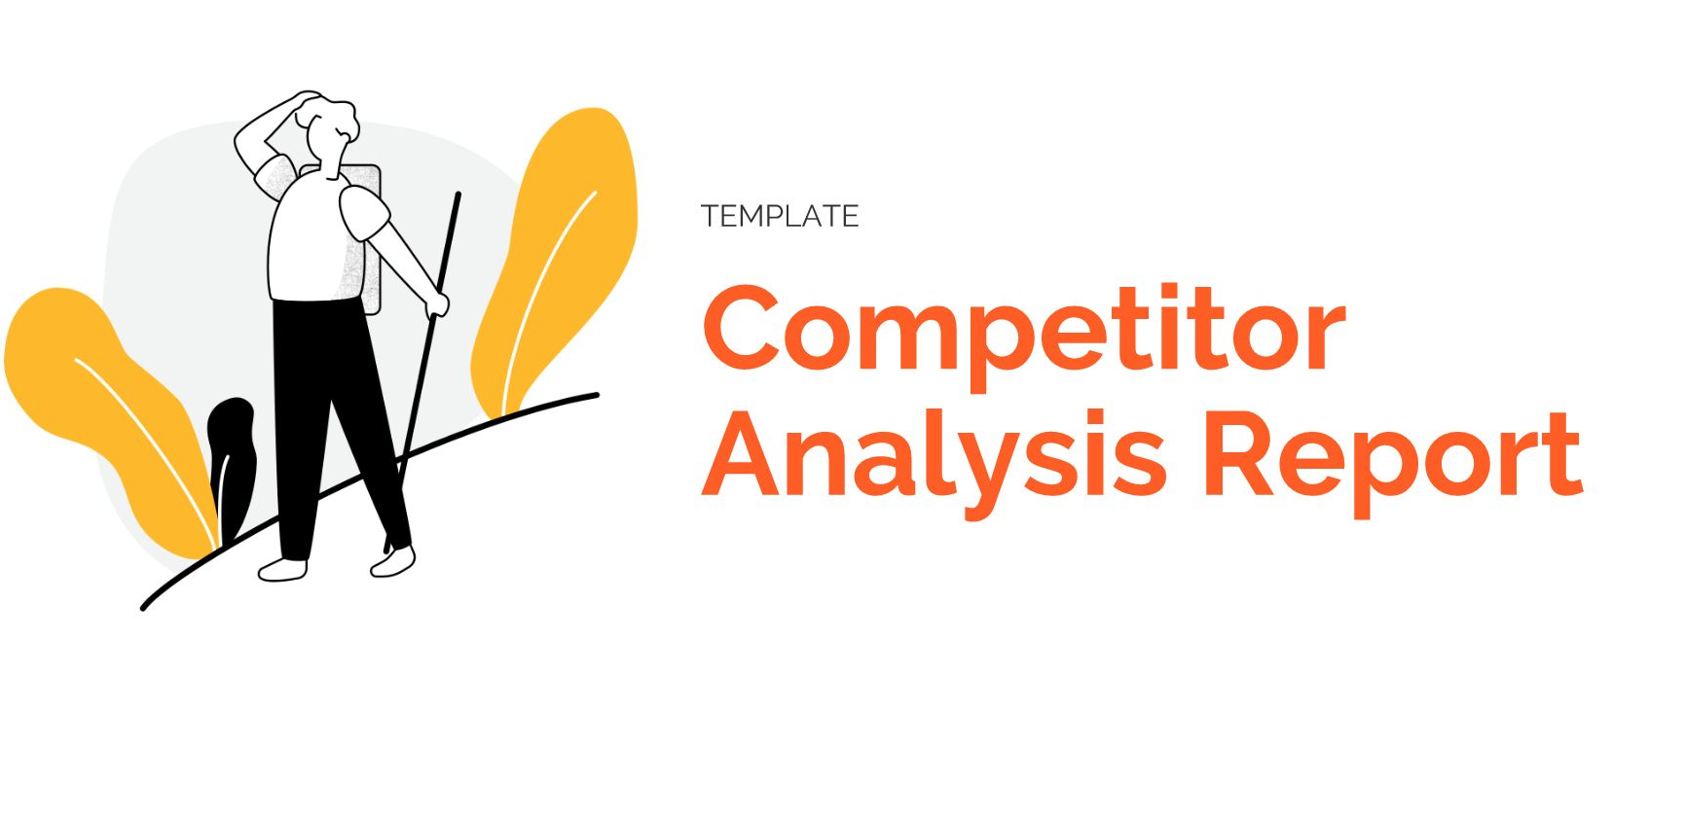


competitor Analysis Report
Arihant Global

Slide 2
keywords
keywords | Url | Speed | position | Intent | Volume | kd
Digital Marketing Company in Jaipur | https://arihantglobal.net/digital-marketing-company-in-jaipur/ | Mobile / Desktop | 51 | Commercial | 4,400 | 36
 |  | 18/63
Digital Marketing Agency in Jaipur | https://arihantglobal.net/digital-marketing-company-in-jaipur/ | 18/63 | 39 | Commercial | 4,400 | 30
social media marketing company in jaipur | https://arihantglobal.net/social-media-agency-in-jaipur/ | 27/63 | 29 | Commercial | 260 | 12
Logo Designer in Jaipur | https://arihantglobal.net/logo-designer-in-jaipur/ | 30/41 | 12 | Commercial | 210 | 14

Slide 3
Last 1 Months Google Search Console
keywords | total click | total impression | CTR % | position
Digital Marketing Company in Jaipur | 7 | 1.05k | 0.9 | 79
Digital Marketing Agency in Jaipur | 0 | 3.93k | 0 | 72.1
social media marketing company in jaipur | 1 | 2.36k | 0.3 | 36.9
Logo Designer in Jaipur | 6 | 475 | 1.8 | 12.7

Slide 4
competitor on Keyword
Digital Marketing Company in Jaipur
keywords | competitor | position | DA /PA/SS |  |  | Number of Backlinks |  | Backlinks Type |  | Blogs | Blog Type | Website speed
Digital Marketing Company in Jaipur | competitor 1 |  |  |  |  |  |  | Dofollow |  | Blogs last |  | Mobile / Desktop
 | https://www.digitalsocialite.in/ | 10 | Da 33 | Pa | SS | 1.7K | 140 | 88% |  | November 15, 2023 | Information | 41 | 27
 |  |  | 13 | 33 | 1%
 | competitor 2
 | https://www.digitalmarketingjaipur.com/ | 13 | DA | PA | SS | 1.6K | 194 | 83% |  | September 25, 2023 | Information | 54 | 63
 |  |  | 22 | 38 | 1%
 | competitor 3
 | https://www.driftclick.com/ | 20 | DA | PA | SS | 714 | 186 | 83% |  | December 13, 2023 | Information | 71 | 79
 |  |  |  |  | 1%
 | competitor 4
 | https://www.reinventdigital.com/ | 21 | DA | PA | SS | 1.3K | 89 | 86% |  | 2024-04-01 | Information | 19 | 41
 |  |  | 15 | 34 | 0
 | competitor 4
 | https://www.arinfotech.co.in/digital-marketing-company.html | 22 | DA | PA | SS | 41 | 22 | 66% |  | March 11, 2024 | Information | 40 | 54
 |  |  | 24 | 35 | 1%

Slide 5
competitor on Keyword
Digital Marketing Agency in Jaipur
keywords | competitor | position | DA /PA/SS |  |  | Number of Backlinks |  | Backlinks Type |  | Blogs | Blog Type | Website speed
Digital Marketing Agency in Jaipur | competitor 1 |  |  |  |  |  |  | Dofollow |  | Blogs last |  | Mobile / Desktop
 | https://www.digitalsocialite.in/ | 8 | Da 33 | Pa | SS | 1.7K | 140 | 88% |  | November 15, 2023 | Information | 41 | 27
 |  |  | 13 | 33 | 1%
 | competitor 2
 | https://thecogent.in/best-digital-marketing-company-in-jaipur/ | 13 | DA | PA | SS | 524 | 59 | 81% |  | No blog |  | 89 | 98
 |  |  | 27 | 16 | 1%
 | competitor 3
 | https://www.digitalmarketingjaipur.com/ | 16 | DA | PA | SS | 1.6k | 194 | 83% |  | September 25, 2023 | Information | 54 | 63
 |  |  | 22 | 38 | 1%
 | competitor 4
 | https://www.reinventdigital.com/ | 23 | DA | PA | SS | 1.3K | 89 | 86% |  | 2024-04-01 | Information | 19 | 41
 |  |  | 15 | 34 | 0
 | competitor 5
 | https://www.webhopers.com/top-digital-marketing-companies-in-jaipur | 26 | DA | PA | SS | 1 | 1 |  |  | 2023-10-28 | Information | 25 | 43
 |  |  | 33 | 33 | 1%

Slide 6
competitor on Keyword
Social media marketing company in jaipur
keywords | competitor | position | DA /PA/SS |  |  | Number of Backlinks |  | Backlinks Type |  | Blogs | Blog Type | Website speed
social media marketing company in jaipur | competitor 1 |  |  |  |  |  |  | Dofollow |  | Blogs last |  | Mobile / Desktop
 | https://www.digitalsocialite.in/ | 4 | Da 33 | Pa | SS | 1.7K | 140 | 88% |  | November 15, 2023 | Information | 41 | 27
 |  |  | 13 | 33 | 1%
 | competitor 2
 | https://www.crossgraphicideas.com/social-media-marketing/ | 6 | DA | PA | SS | 36 | 18 | 61% |  | November 18, 2023 | Information | 5 | 29
 |  |  | 34 | 21 | 1%
 | competitor 3
 | https://thecogent.in/best-digital-marketing-company-in-jaipur/ | 15 | DA | PA | SS | 524 | 59 | 81% |  | No blog |  | 89 | 98
 |  |  | 16 | 27 | 1%
 | competitor 4
 | https://www.digitalmarketingjaipur.com/ | 18 | DA | PA | SS | 1.6K | 194 | 83% |  | September 25, 2023 | Information | 54 | 63
 |  |  | 22 | 38 | 1%
 | competitor 5
 | https://thecogent.in/best-social-media-marketing-company-in-jaipur/ | 25 | DA | PA | SS | 28 | 5 | 89% |  | No blog |  | 88 | 99
 |  |  | 16 | 20 | 1%

Slide 7
competitor on Keyword
Logo Designer in Jaipur
keywords | competitor | position | DA /PA/SS |  |  | Number of Backlinks |  | Backlinks Type |  | Blogs | Blog Type | Website speed
Logo Designer in Jaipur | competitor 1 |  |  |  |  |  |  | Dofollow |  | Blogs last |  | Mobile / Desktop
 | https://www.digiwebart.com/logo-design/ | 3 | Da | Pa | SS | 96 | 33 | 13% |  | 2021-09-04 | Information | 28 | 72
 |  |  | 17 | 37 | 1%
 | competitor 2
 | https://dotndashgraphics.com/ | 11 | DA | PA | SS | 836 | 25 | 90% |  | No blog |  | 27 | 30
 |  |  | 10 | 26 | 0%
 | competitor 3
 | https://www.crossgraphicideas.com/logo-design/ | 12 | DA | PA | SS | 194 | 46 | 51% |  | November 18, 2023 | Information | 18 | 40
 |  |  | 21 | 34 | 1%
 | competitor 4
 | https://www.graphicstudio.co.in/ | 14 | DA | PA | SS | 127 | 9 | 54% |  | No blog |  | 60 | 68
 |  |  | 10 | 22 | 2%
 | competitor 5
 | https://www.vervebranding.com/logo-design-company-in-jaipur.html | 25 | DA | PA | SS | 33 | 6 | 68% |  | November 15, 2023 | Information | 54 | 38
 |  |  | 26 | 26 | 4%

Slide 8

Competitor Backlinks
Total Backlinks = 114

Slide 9
NEW CITY WISE KEYWORD
Keywords | Volume | Keyword Difficulty | Intent
Digital marketing company in Bangalore | 3.6k | 52 | Commercial
Digital marketing company in Chennai | 2.4k | 52 | Commercial
Digital marketing company in Kolkata | 3.6k | 50 | Commercial
Digital marketing company in Amritsar | 1.9k | 15 | Commercial
Digital marketing company in Bhopal | 1.3k | 26 | Commercial
Digital marketing company in Bhubaneswar | 880 | 17 | Commercial
Digital marketing company in Chandigarh | 1.9k | 18 | Commercial
Digital marketing company in Faridabad | 480 | 14 | Commercial
Digital marketing company in Ghaziabad | 590 | 16 | Commercial
Digital marketing company in Jamshedpur | 110 | 2 | Commercial
Digital marketing company in Kochi | 720 | 38 | Commercial
Digital marketing company in Lucknow | 3.6k | 22 | Commercial
Digital marketing company in Nagpur | 880 | 18 | Commercial
Digital marketing company in Raipur | 880 | 20 | Commercial
Digital marketing company in Surat | 1k | 15 | Commercial
Digital marketing company in Visakhapatnam | 20 | 0 | Commercial
Digital marketing company in Kanpur | 390 | 20 | Commercial

Slide 10
OLD Websites CITY WISE KEYWORD
Keywords | URL | position
Digital Marketing Company In Hyderabad | https://arihantglobal.net/best-digital-marketing-company-in-hyderabad/ | not under 70
Digital Marketing Agency In Allahabad | https://arihantglobal.net/best-digital-marketing-agency-in-allahabad/ | 22
Digital Marketing Agency in Shekhawati | https://arihantglobal.net/best-digital-marketing-agency-in-shekhawati/ | 1
Best Digital Marketing Agency in Vadodara | https://arihantglobal.net/best-digital-marketing-agency-in-vadodara/ | 37
Best Digital Marketing Company in Gurgaon | https://arihantglobal.net/best-digital-marketing-company-in-gurgaon/ | not under 70
Best Digital Marketing Company in Jodhpur | https://arihantglobal.net/best-digital-marketing-company-in-jodhpur/ | 23
Digital Marketing Agency In Kota | https://arihantglobal.net/digital-marketing-agency-in-kota/ | 16
Best Digital Marketing Company in Udaipur | https://arihantglobal.net/best-digital-marketing-company-in-udaipur/ | 21
Digital marketing agency in Delhi | https://arihantglobal.net/digital-marketing-agency-in-delhi/ | not under 70
Best Digital Marketing Agency In Guwahati | https://arihantglobal.net/digital-marketing-agency-in-guwahati/ | 41
Digital Marketing Agency In Pune | https://arihantglobal.net/digital-marketing-agency-in-pune/ | not under 70
Digital Marketing Company In Gorakhpur | https://arihantglobal.net/digital-marketing-company-in-gorakhpur/ | 12
Digital Marketing Agency In Mumbai | https://arihantglobal.net/digital-marketing-agency-in-mumbai/ | not under 70
Digital Marketing Company In Ajmer, | https://arihantglobal.net/digital-marketing-company-in-ajmer-rajasthan/ | 8
Digital Marketing Company In Aligarh | https://arihantglobal.net/digital-marketing-company-in-aligarh/ | 13
Digital Marketing Company In Agra | https://arihantglobal.net/digital-marketing-company-in-agra-2/ | 25
Digital Marketing Agency In Bikaner | https://arihantglobal.net/digital-marketing-agency-in-bikaner/ | 10
Digital Marketing Company In Patna | https://arihantglobal.net/digital-marketing-company-in-patna/ | 44
Digital Marketing Company In Noida | https://arihantglobal.net/digital-marketing-company-in-noida/ | not under 70

Slide 11
Conclusion
My work
optimize a page seo friendly
450 Backlinks one day 10
change page layout proper seo friendly
blog posting on trending topic 12
Web story posting on trending topics per day 2
properly call to action
FAQ in pages
Old city wise page optimize total page 18
Create a new city wise page total 17
fixed website Grammarly error

